Slide 1
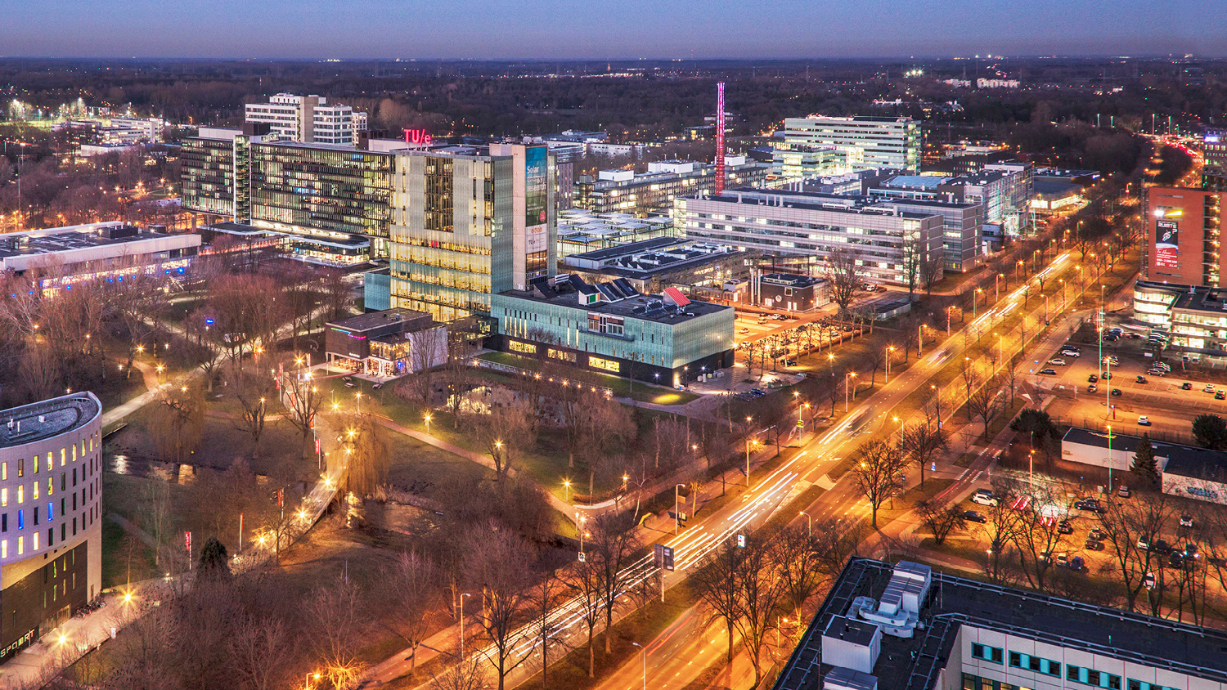
BEP Daniel Tyukov 2024-2025 B
Monday, 10 February 2025
Timo Matray
IC group, Department of Electrical Engineering

Slide 2
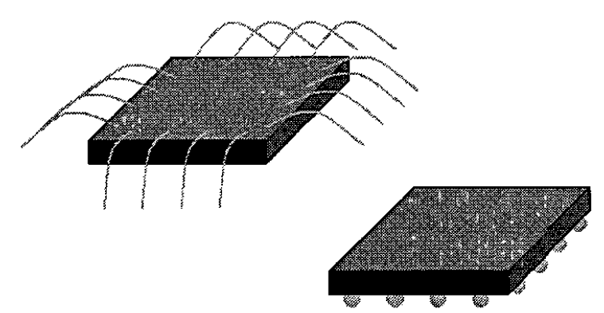
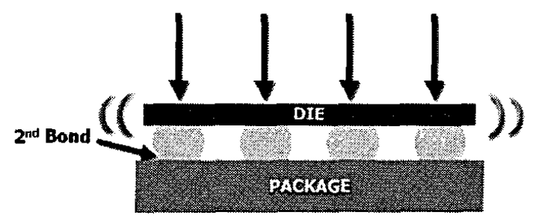
Flip chip technology [1]
Shorter connections → increased speed/bandwidth
Higher pad density → enables array
Co-integration of different substrates → electronic/photonic integration
Wire bonding
Flip chip

Slide 3
The gold bumps
To attach the die to the package, we use gold ball bumps. These act as a glue and connection between the pads of the die and the package.
In the previous setup we’ve attached these gold bumps to the package and flip the chip onto it to attach it.
The ball bumps are created using the wire bonding machine and placing the start and end of the wire in the same location.
Any combination of heat, pressure and ultrasound can be used the attach the die to the package.

Slide 4
The interposer
For integration of large arrays of DACs and connecting them to a photonic beamformer, we require an interposer
The DAC array is a 2D grid, whereas the beamformer is a 1D array. Implementing the DAC in a 1D array is possible in theory, but the cost of the silicon chips makes this unviable.
An interposer is comparable to a PCB, but higher quality. At the TU/e we can produce single gold layer interposers on a glass substrate.
Compared to PCBs the interposer is much flatter. This allows for the use of flip chipping.

Slide 5
Objectives
Characterization of interposer
How do different production methods impact
the interposers performance?
the connection yield?
Flip chip
What is the typical yield of the connections during flip chipping?
What is the quality of the connections between the chip and interposer?
DC resistance (statistical distribution?)
Frequency response

Slide 6
Deliverables and meetings
BEP marketplace
Code of conduct
Initial planning (PRV 52)
Revised planning (PRV 53)
Intermediate Paper (graded, but weight 0%)
Reflection report (PRV43)
Final paper (PRV33)
Presentation (PRV23)

Slide 7
Deliverables and meetings – cont’d
Weekly meetings with Timo, bi-weekly meetings with Marco
Paper drafts are possible and advised but not required.
Academic writing workshop (PRV33)
Information skills session (PRV63)
Please send your specific dates and deadlines to t.m.matray@tue.nl, as these change for each BEP project.

Slide 8
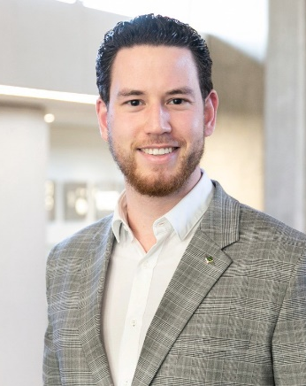
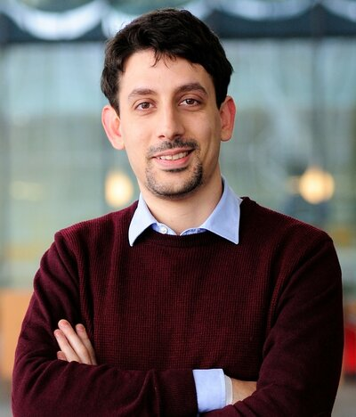
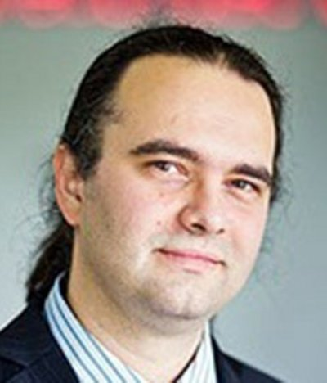
Contact info
ir. Timo Matray
Assistant/daily supervisor
t.m.matray@tue.nl
Flux 7.085
prof. Marco Fattori
Assistant supervisor
m.fattori@tue.nl
Flux 7.096
prof. Georgi Radulov
Responsible supervisor
g.radulov@tue.nl
Flux 7.089

Slide 9
References
J. Jordan, "Gold stud bump in flip-chip applications," 27th Annual IEEE/SEMI International Electronics Manufacturing Technology Symposium, San Jose, CA, USA, 2002, pp. 110-114, doi: 10.1109/IEMT.2002.1032735.

